Slide 1
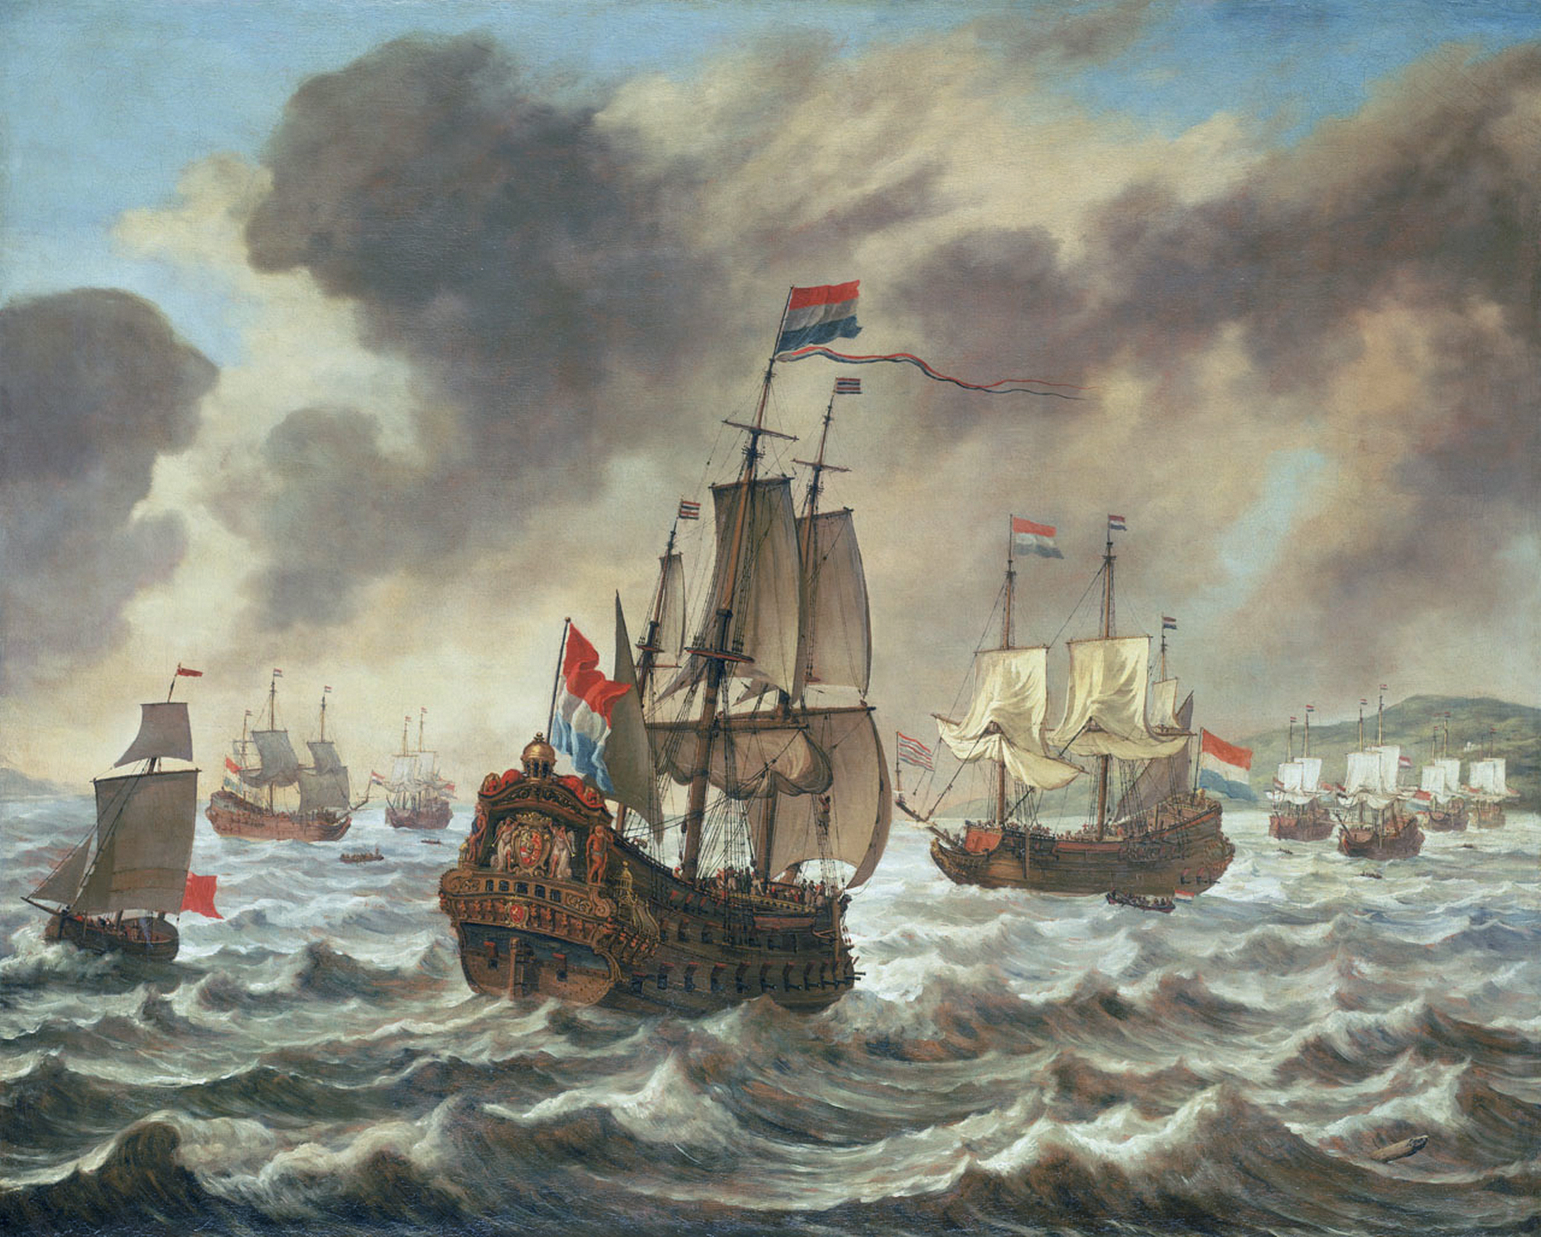
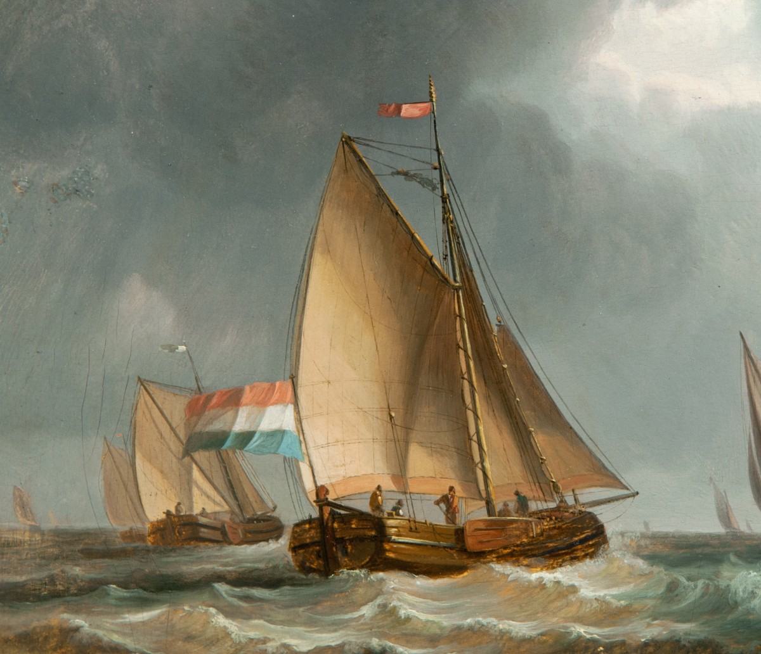
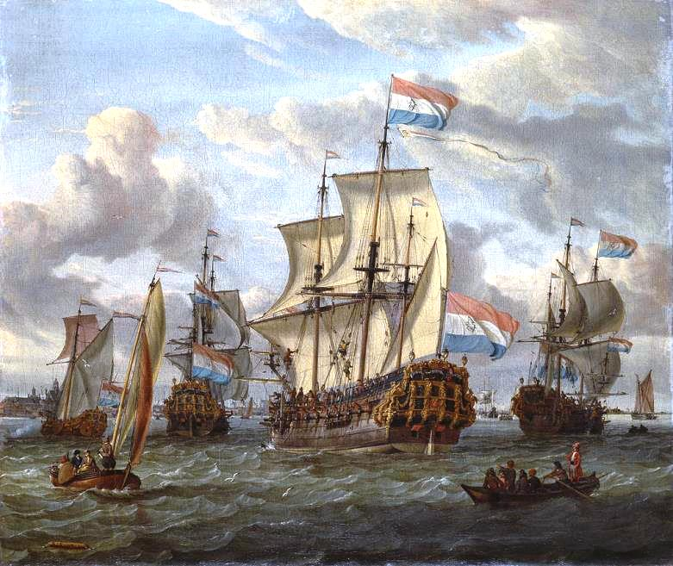
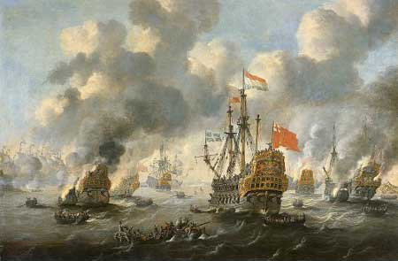
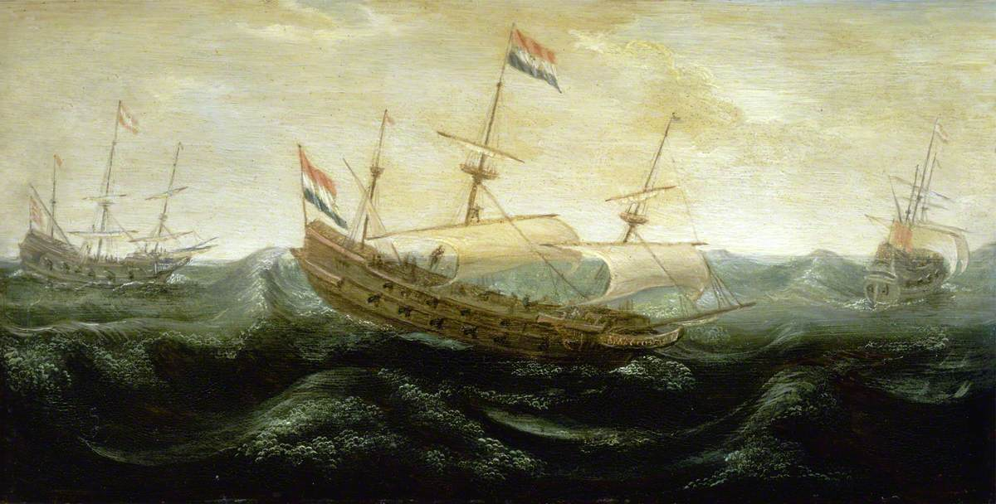
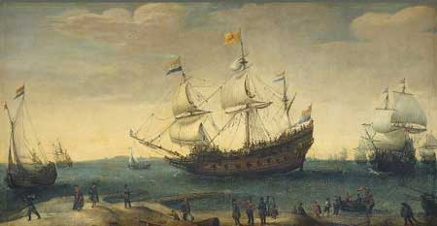
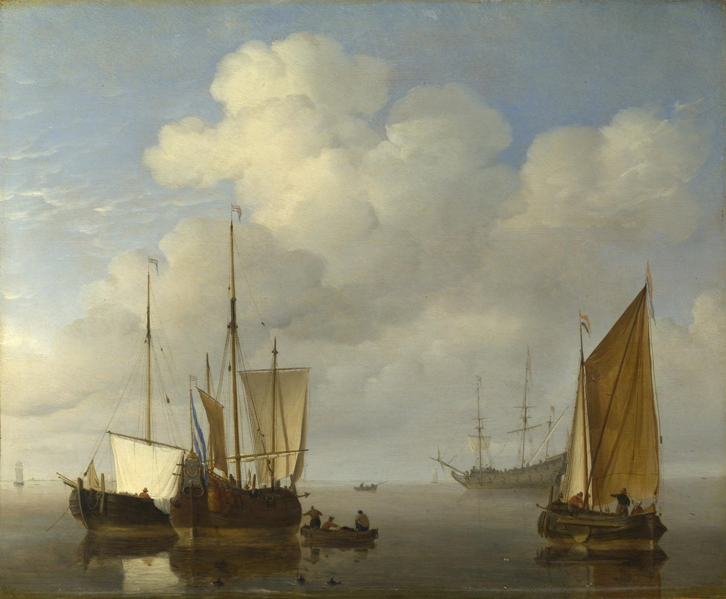
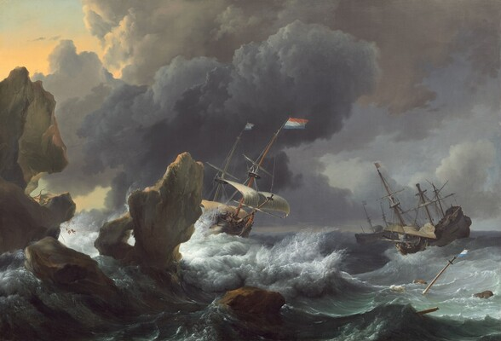
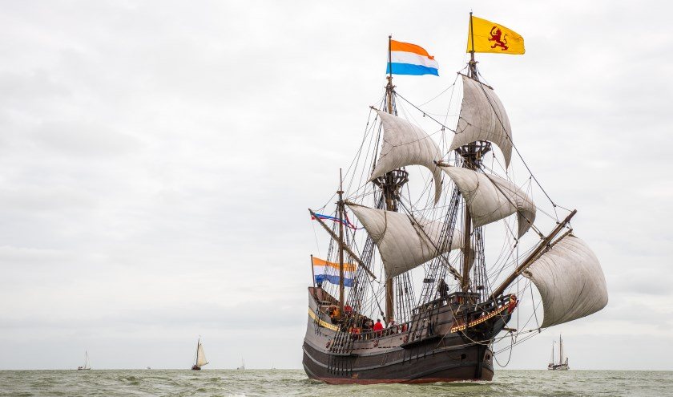
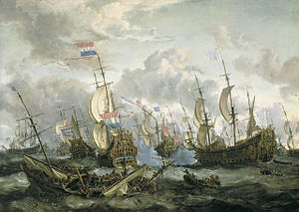
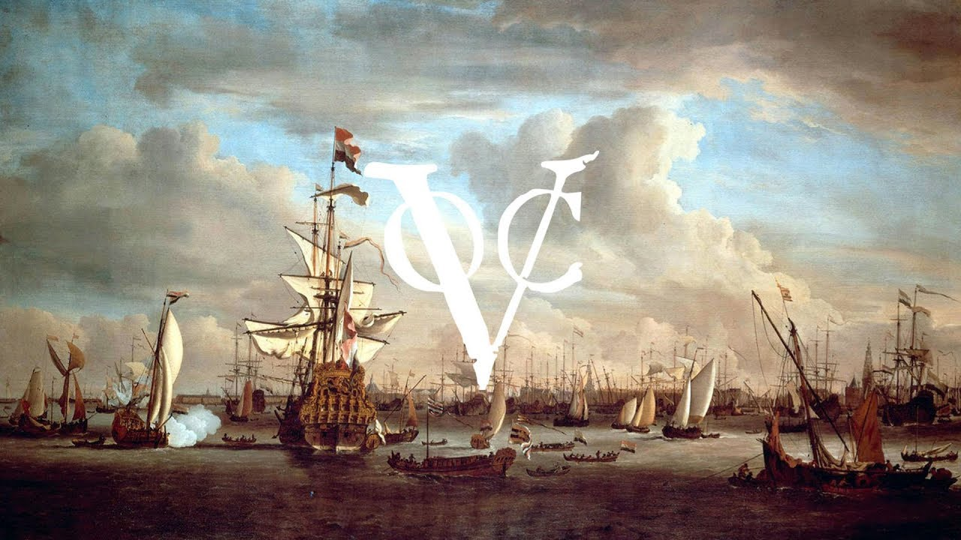
SHIPS

Slide 2
SHIPS

Slide 3
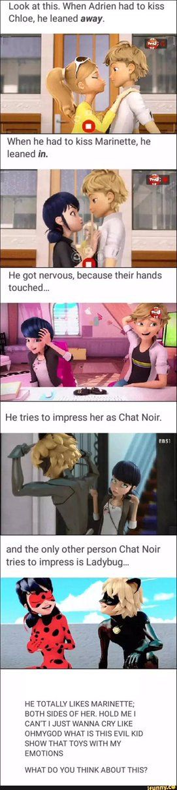
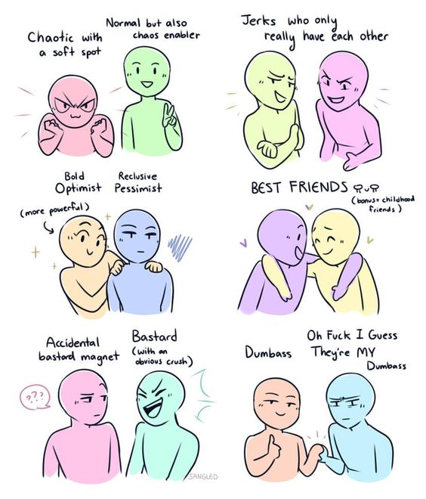

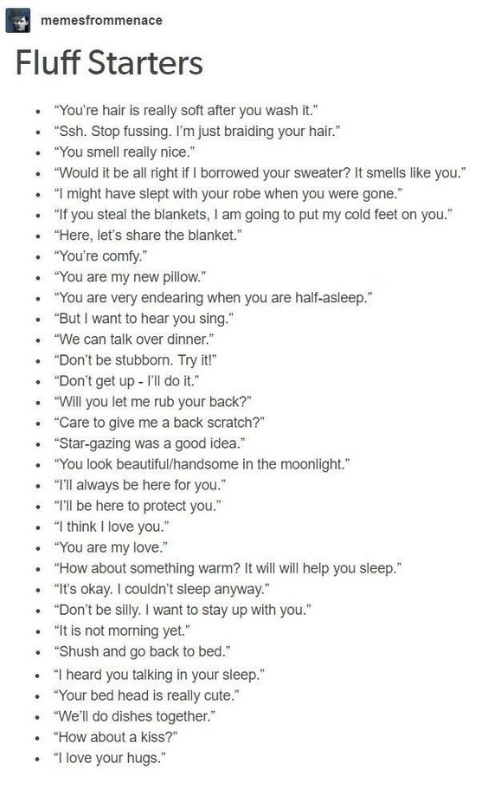
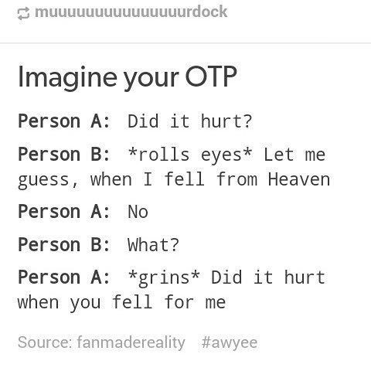

SHIPS
By: Carmen (me)

Slide 4

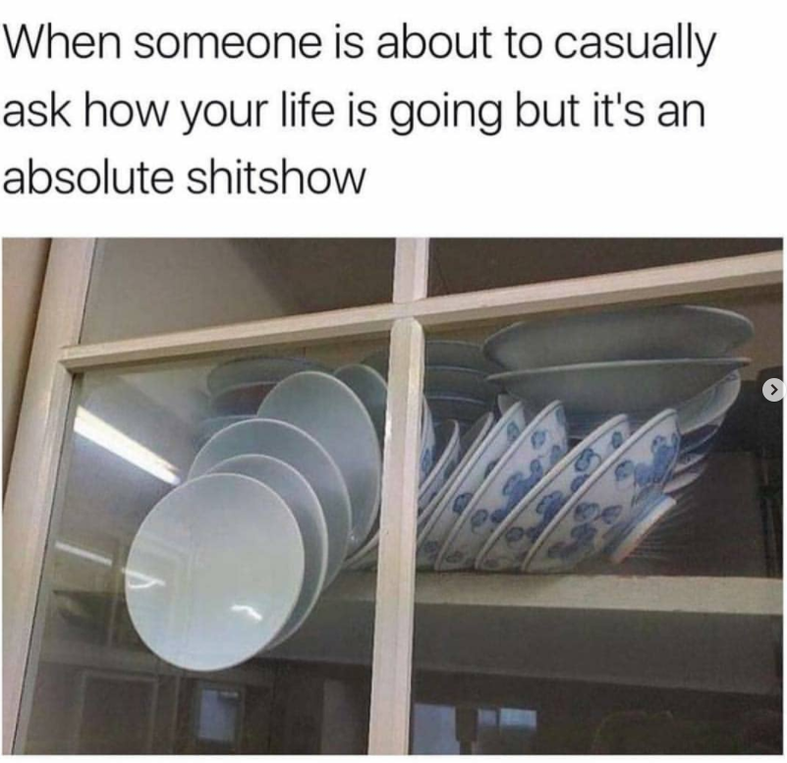

Shippping: WHYYY?
You’re lonely
You have no (love) life
(and if you do it’s too boring)
You deserve to feel something in this miserable world

Slide 5
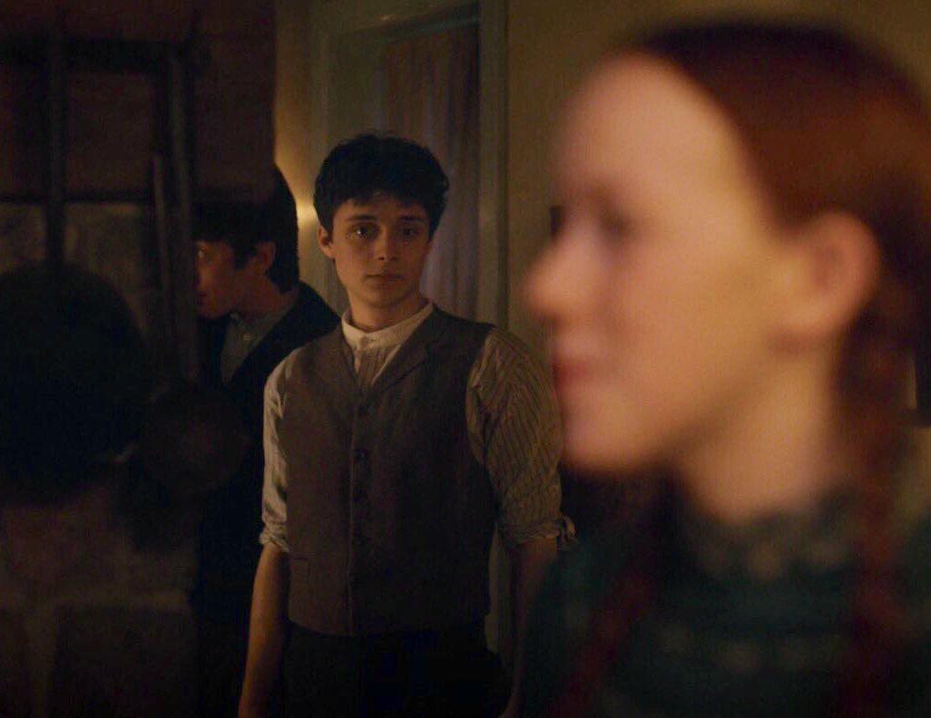
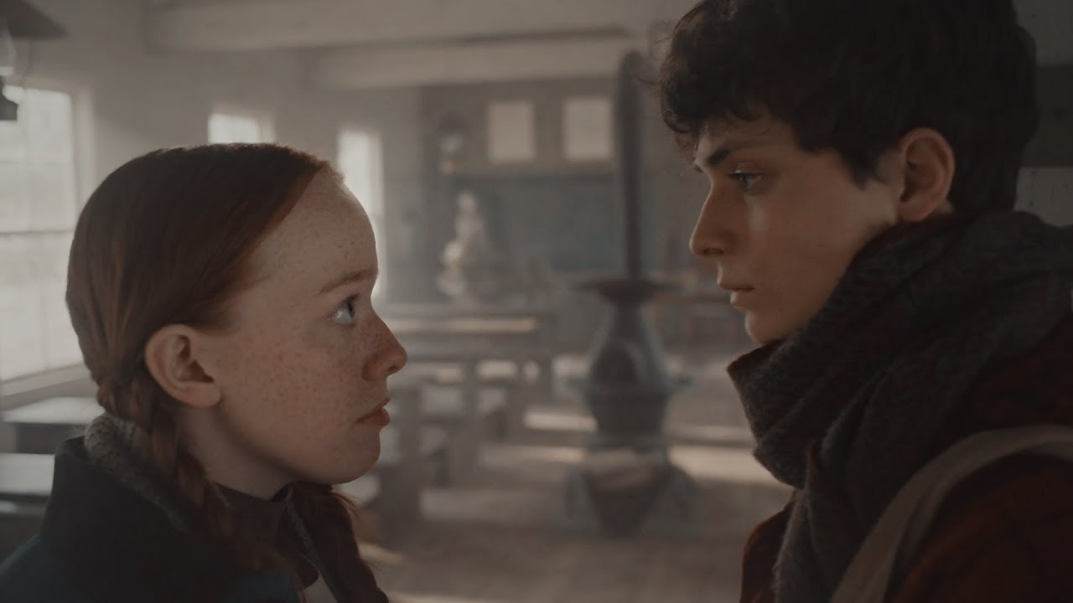
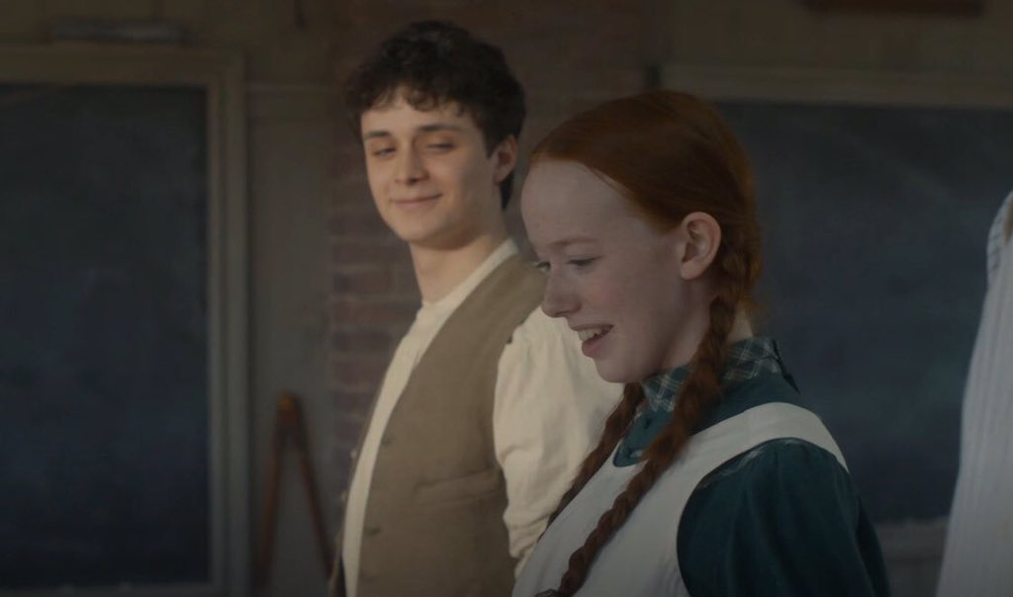
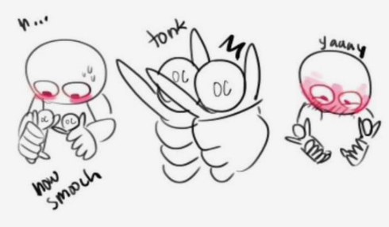
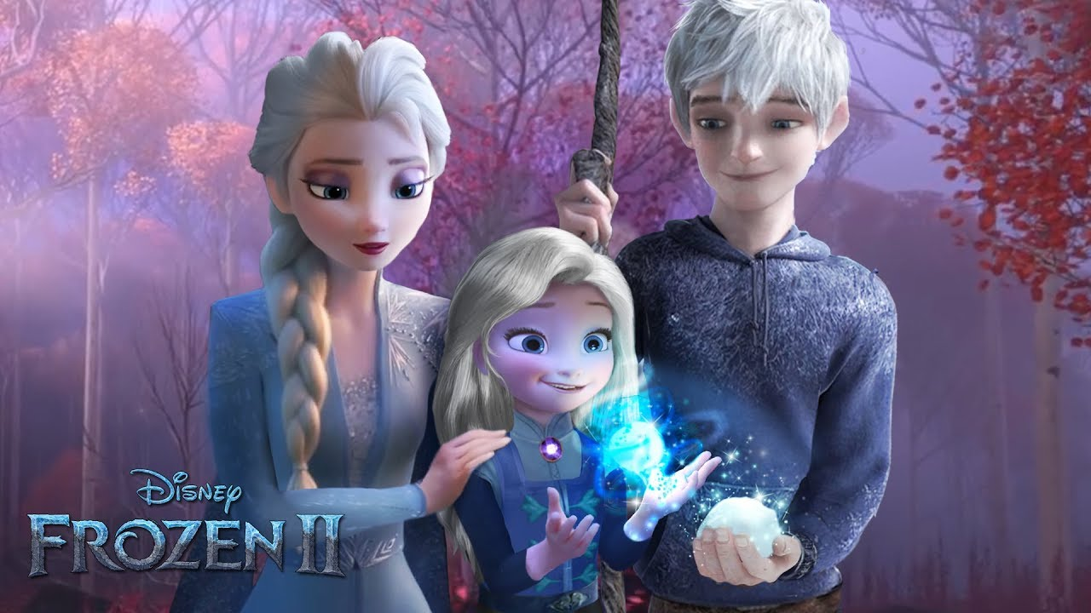
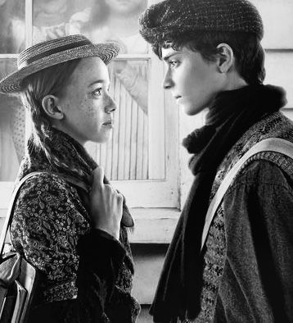
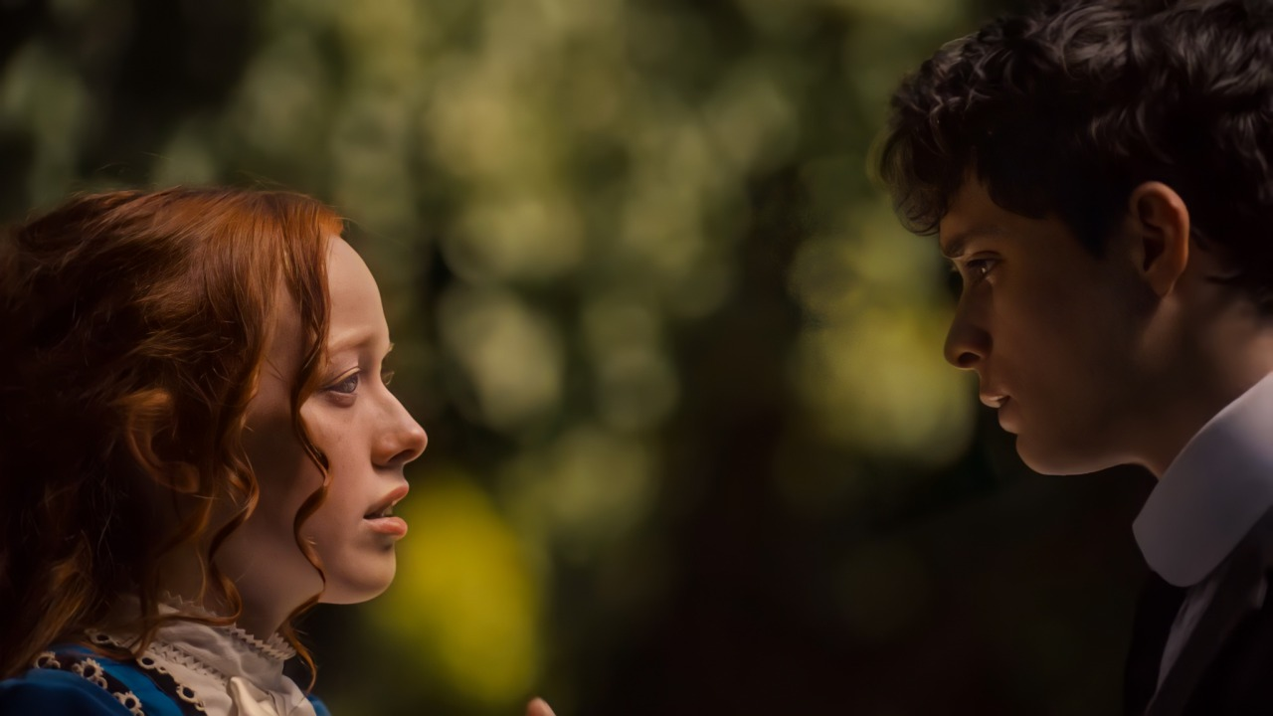
How to look for things to ship: reading into things
Eye contact
Smiles
Indirect kisses
Touching
Taking care of each other
Basically anything if you put your mind to it

Slide 6
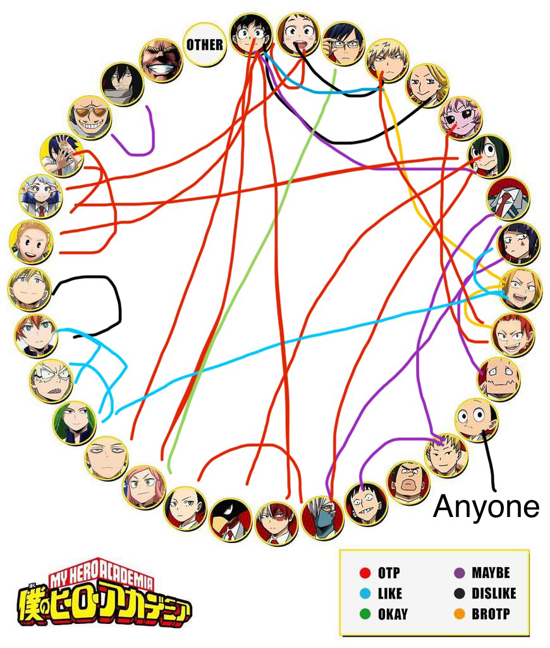
D&D ships I have
And you should too
In order

Slide 7
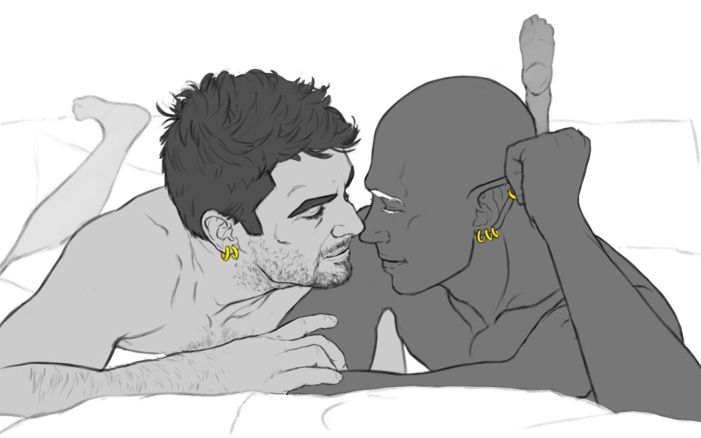


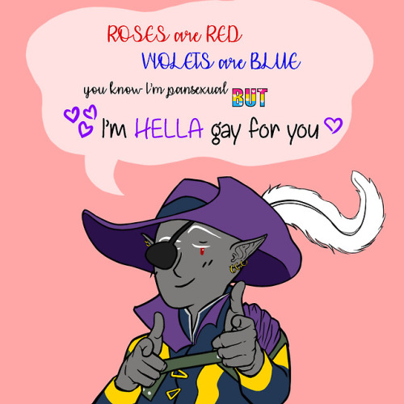
Jarlaxle
Hot!
Flirty
Versatile
Adventurous
Powerful male drow in a matriarchal society
UwU
Up for anything
LOOK AT HIM!
Farris dislikes him (for no reason btw)

Slide 8
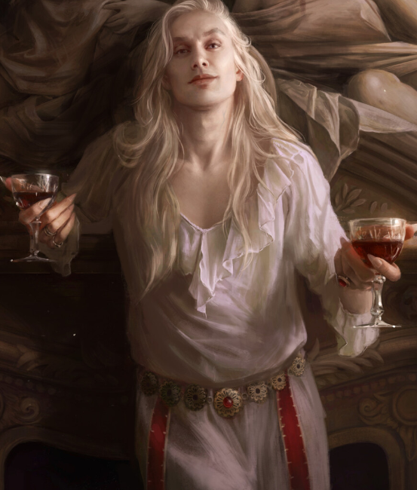
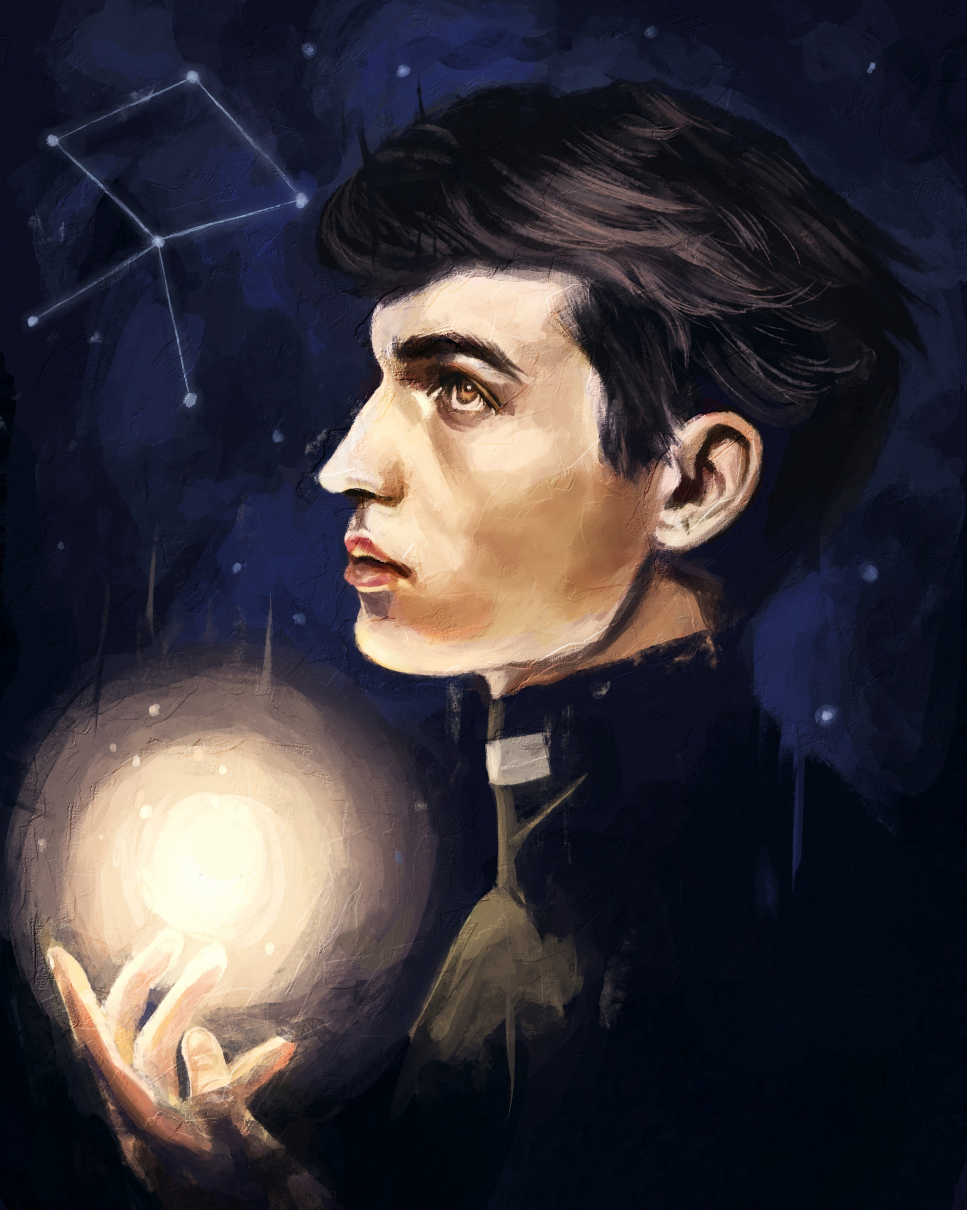

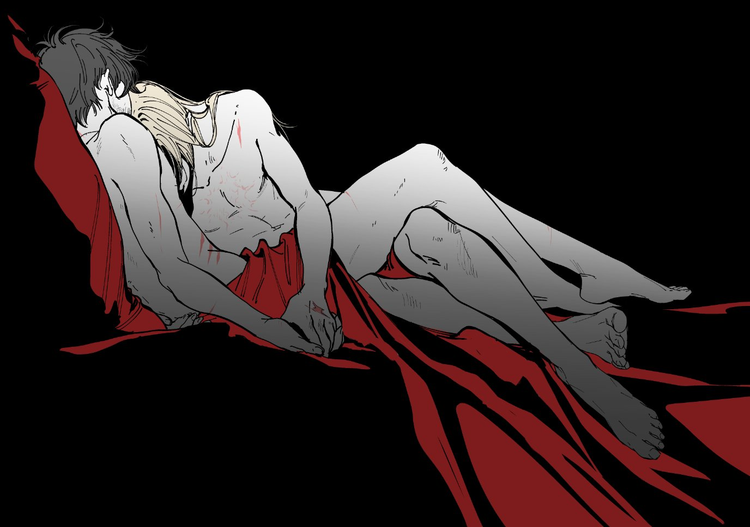

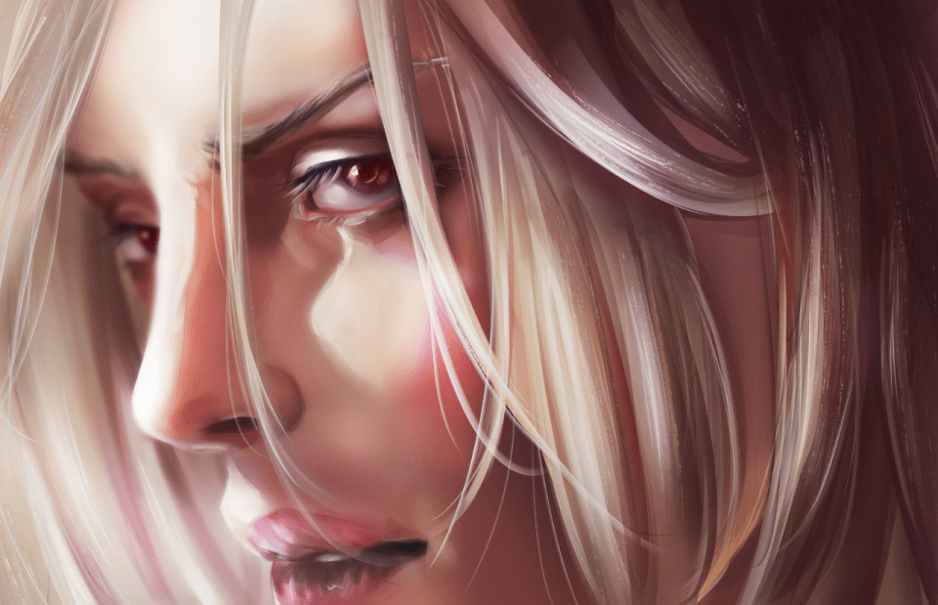
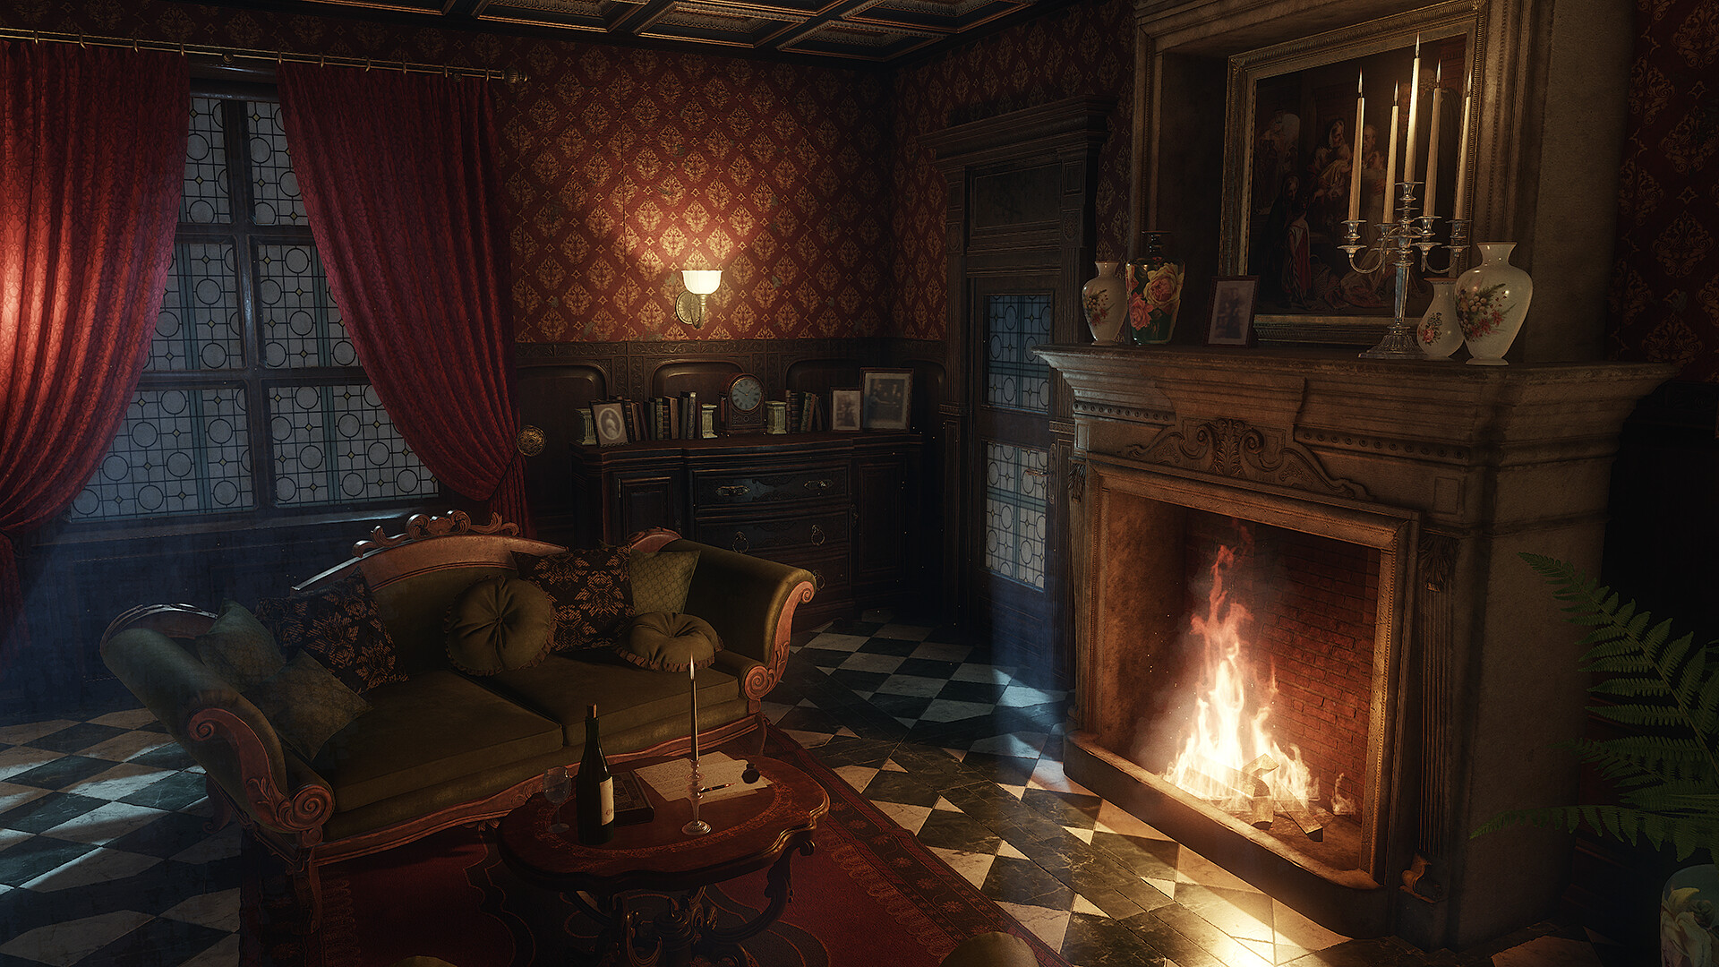
Baron Vasile x Lorentz
Priest and a vampire I mean come on
Both hot
The baron will learn to love again
Lorentz learns not to be such a prude
The baron is rich

Slide 9
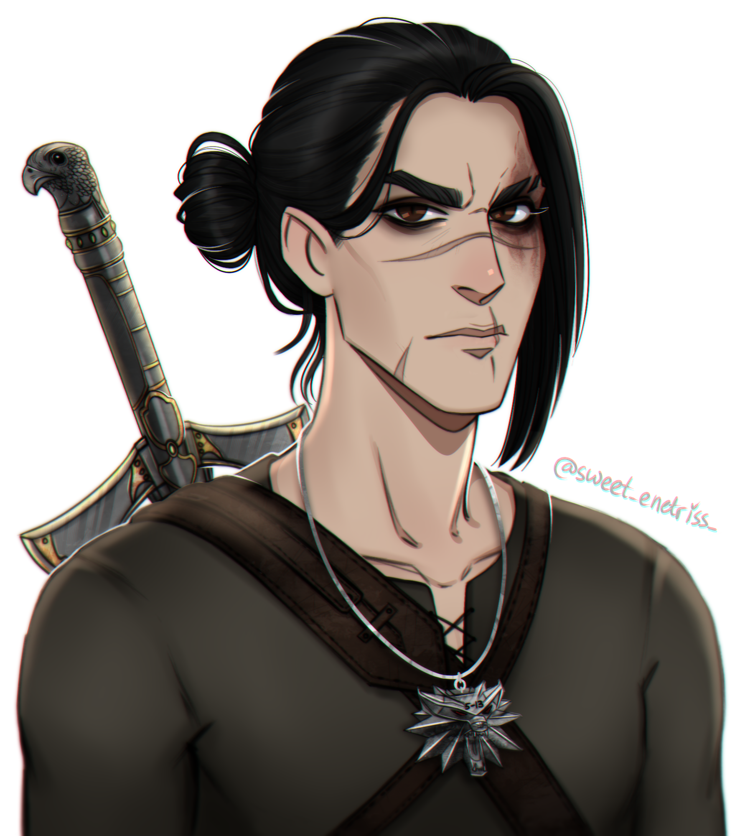
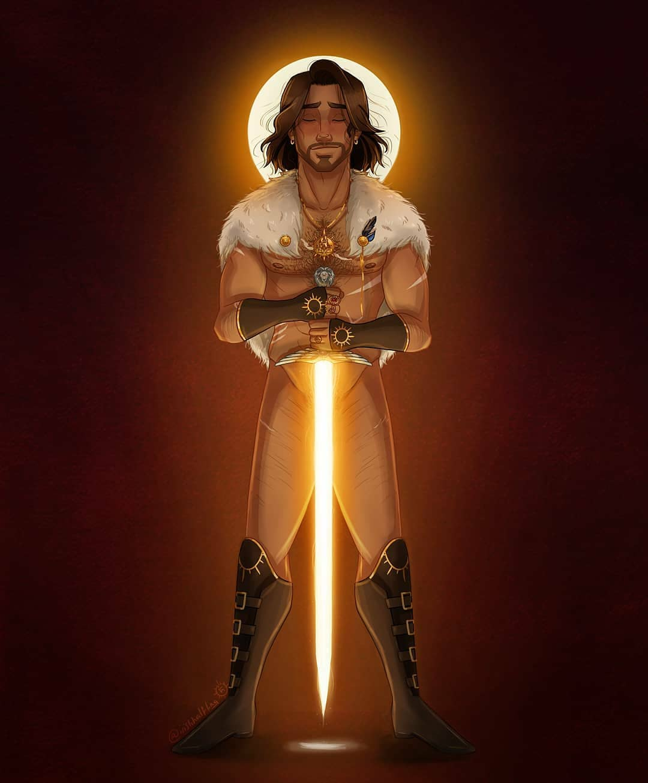

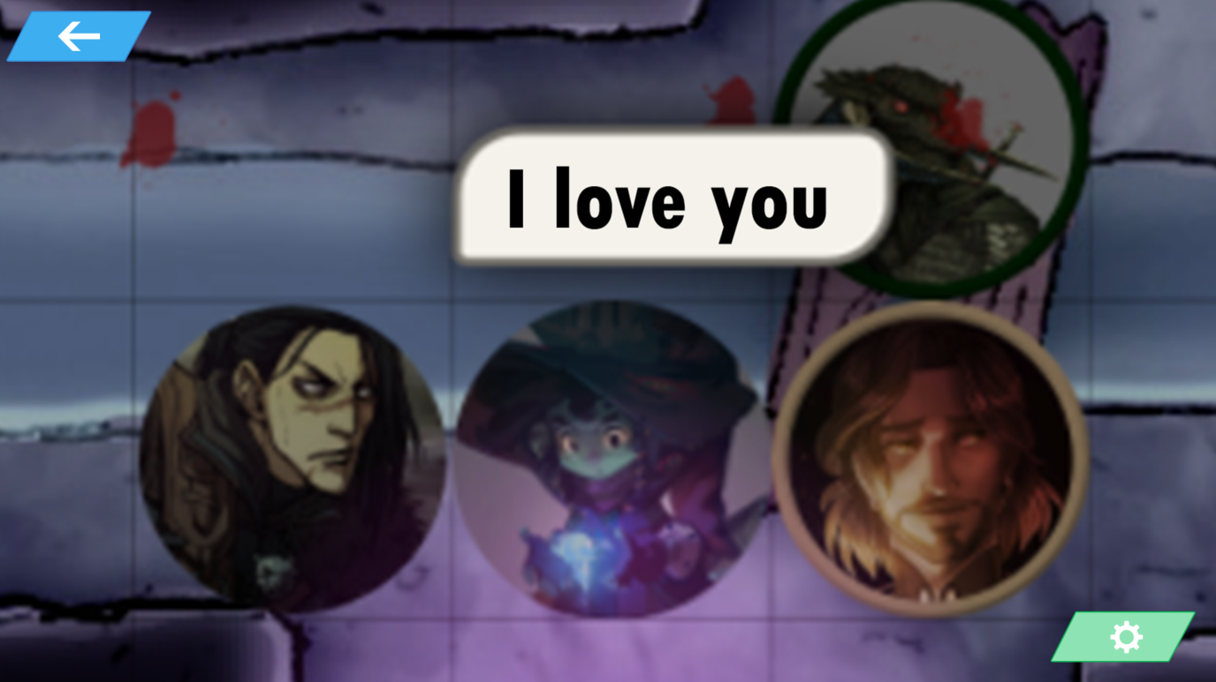
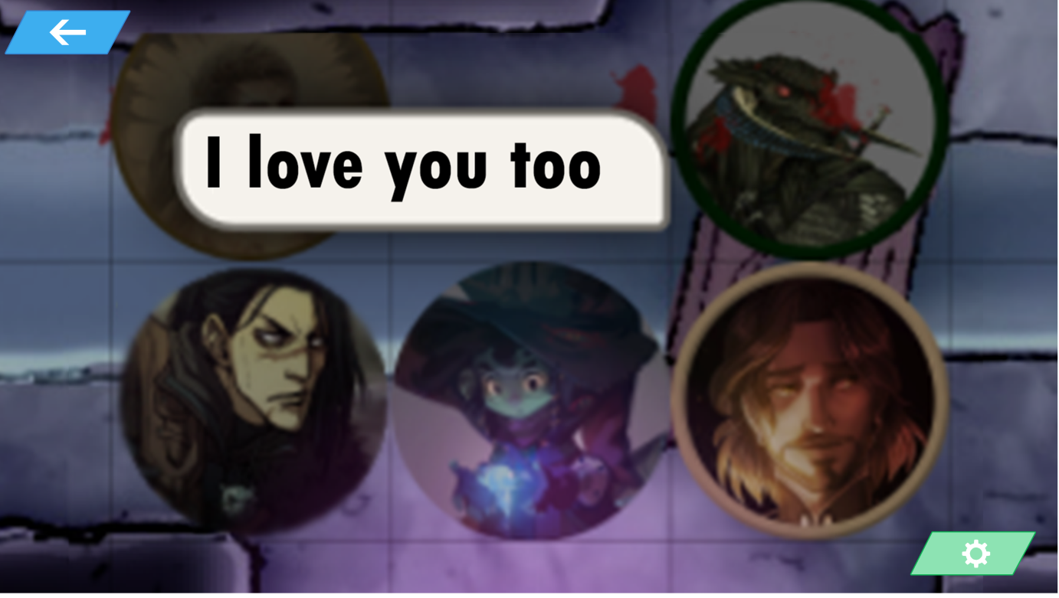
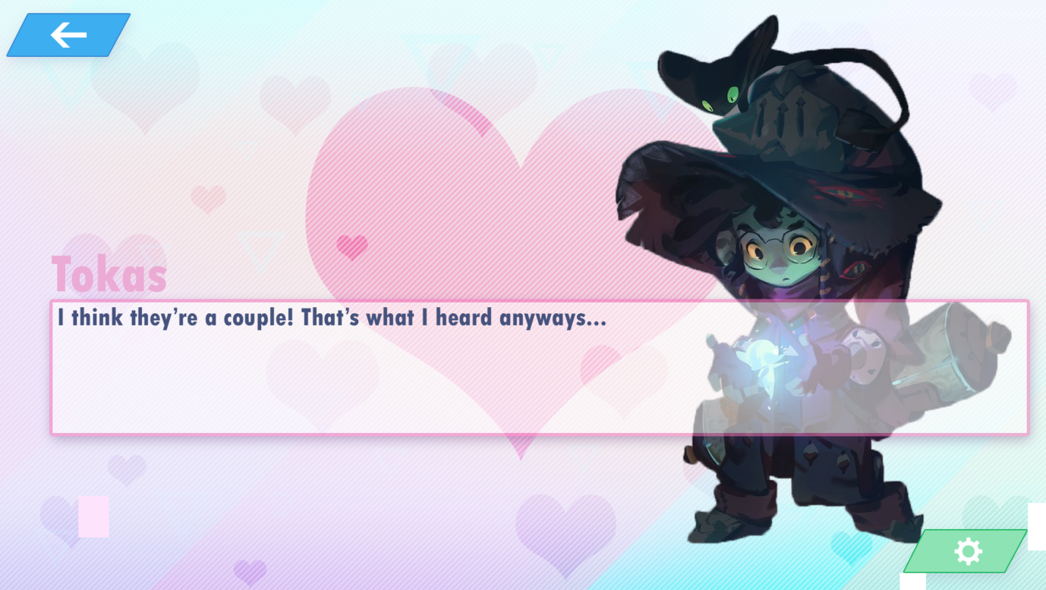
Sairen X Vittorio
“I’ll protect you”
Sairen is the talkative one and Vittorio keeps him grounded
The taking care of each others wounds scene (UwU)
Is cannon in the etharis dating sim

Slide 10
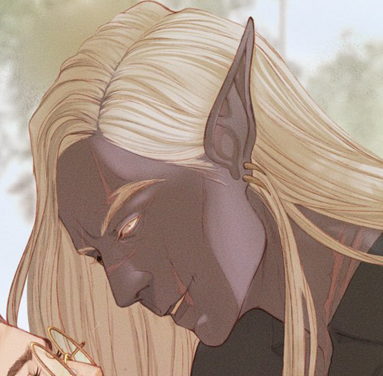
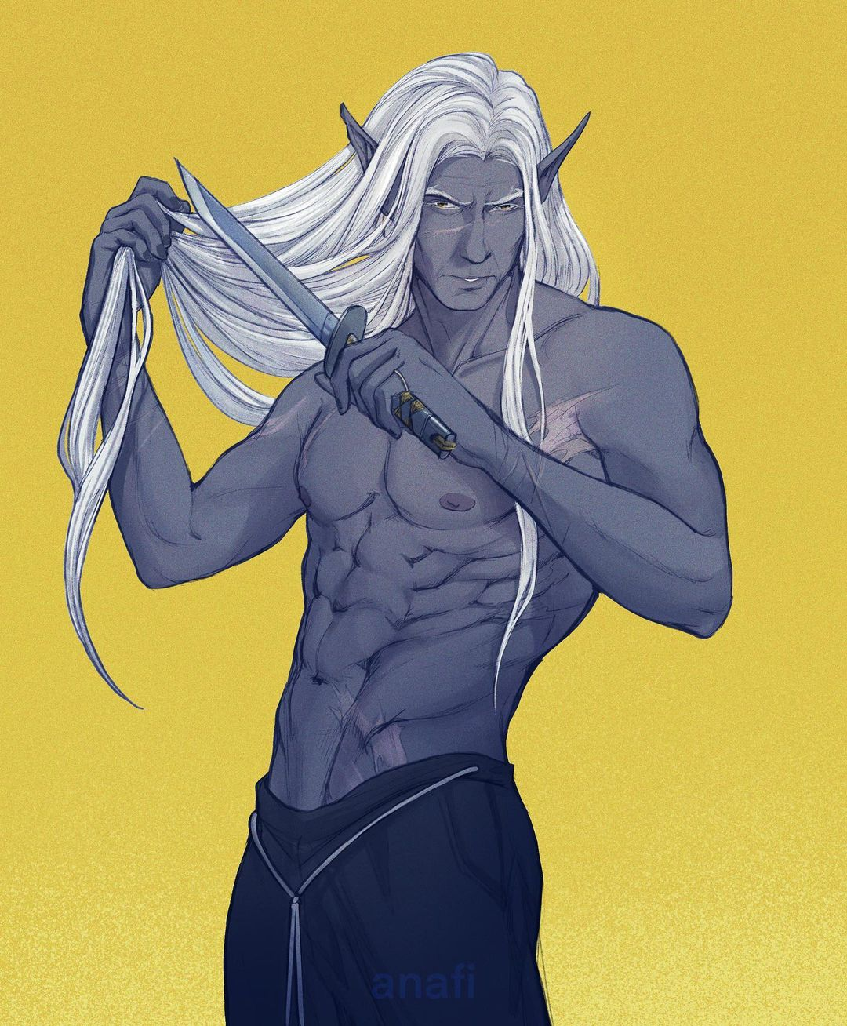
Mazat x Tripp
Mazati does the talking Tripp supports
Mazati is amazing in general and deserves a daddy of his own
Tripp took over when Mazati almost died meaning Mazati trusts him
They rode into an almost unwinnable battle together (power couple)
Both drow
They already basically have children together

Slide 11
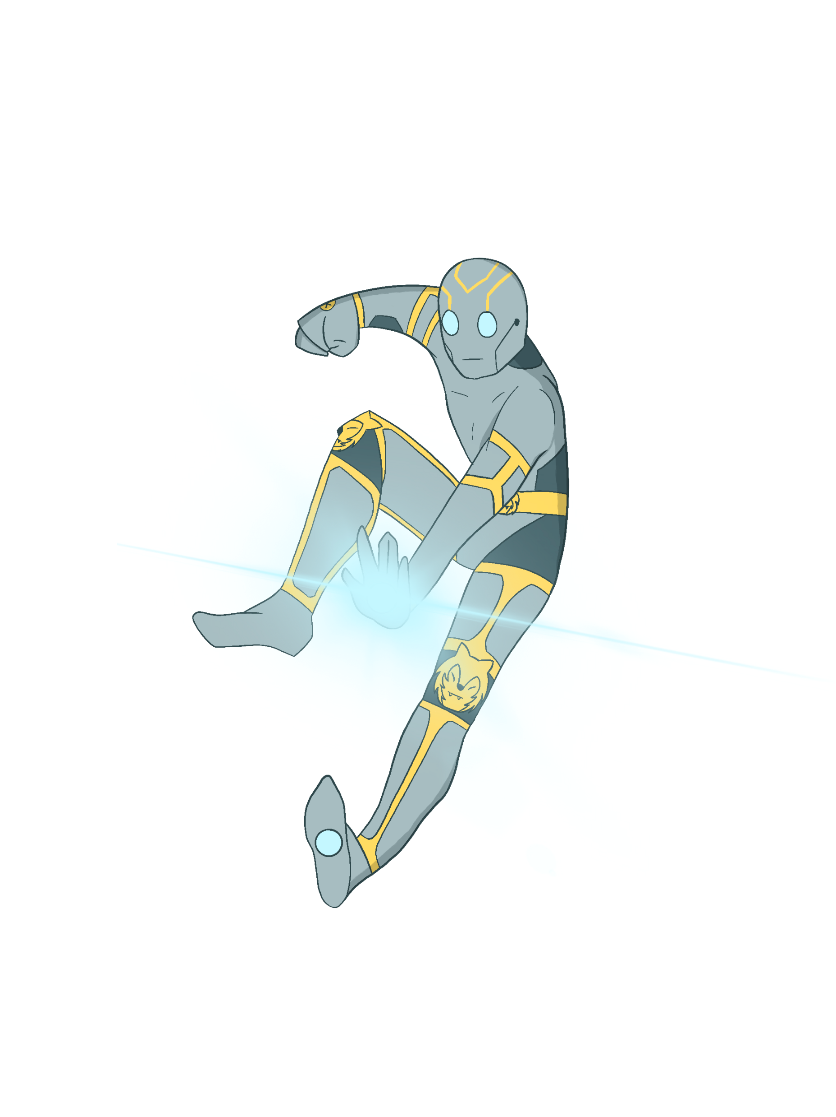
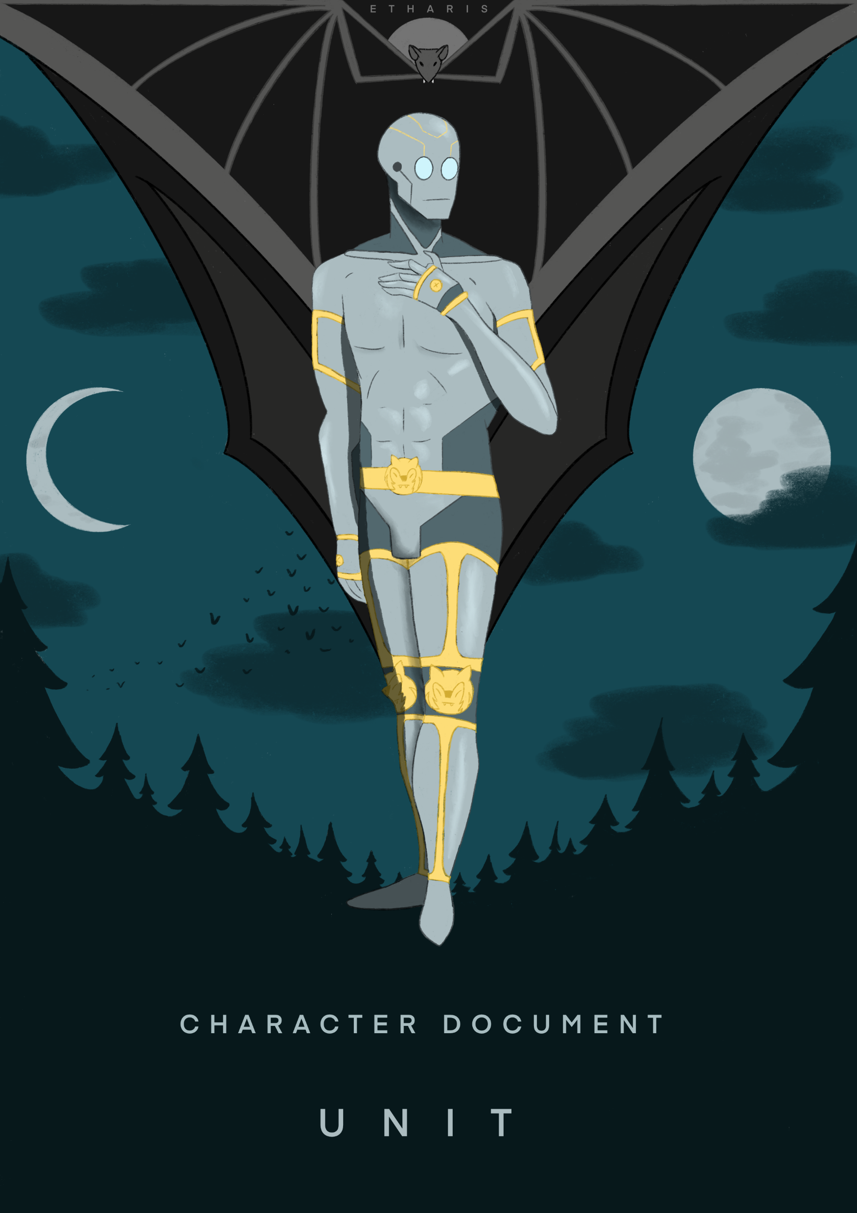
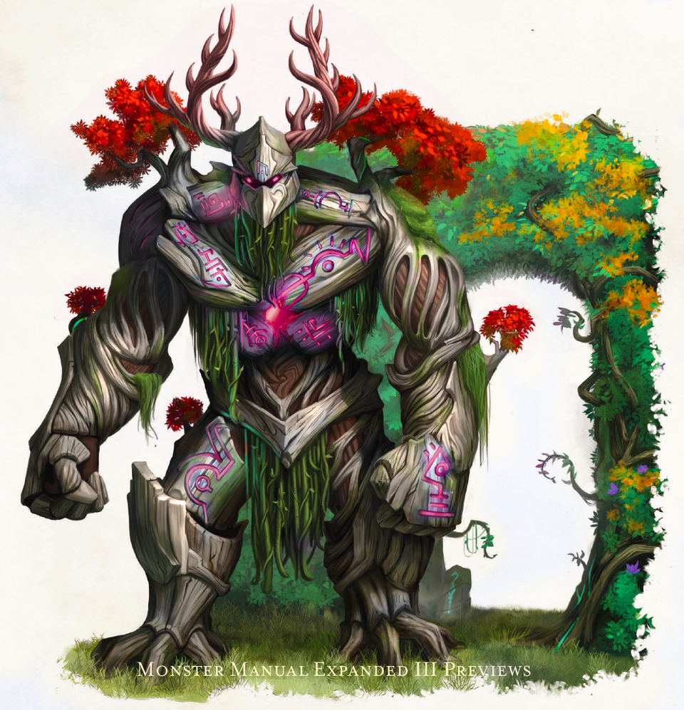
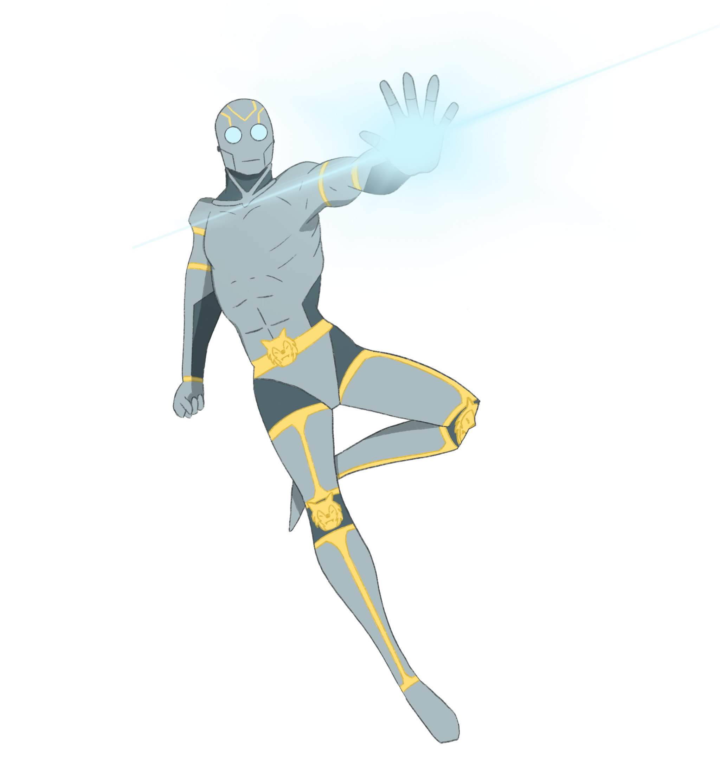

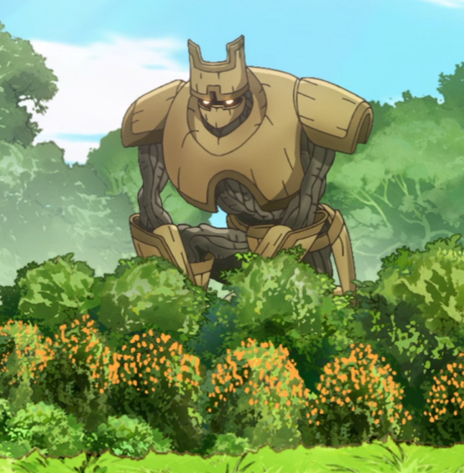

Unit x Unknown
Cute language of their own (communication is important)
Have made more physical contact than with anyone else
Unknown would be a good dad to Puppy
Unknowns world literally changed when Unit touched him

Slide 12
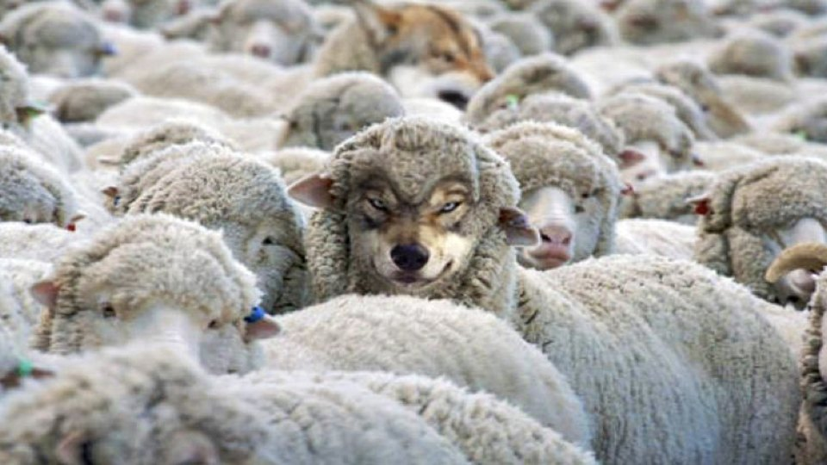

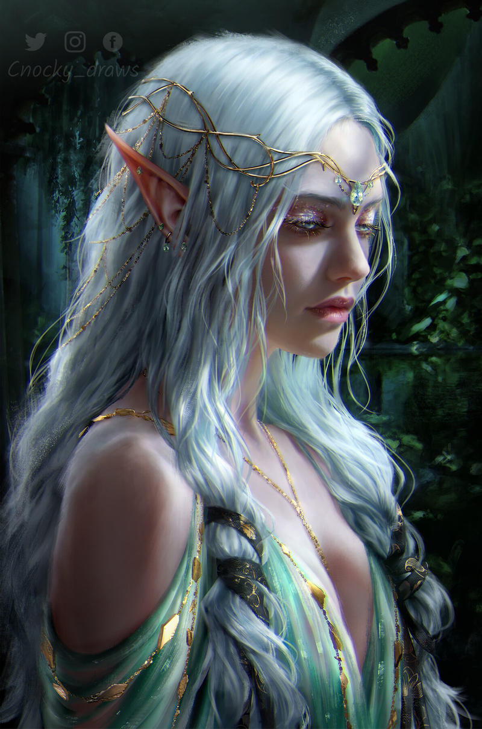
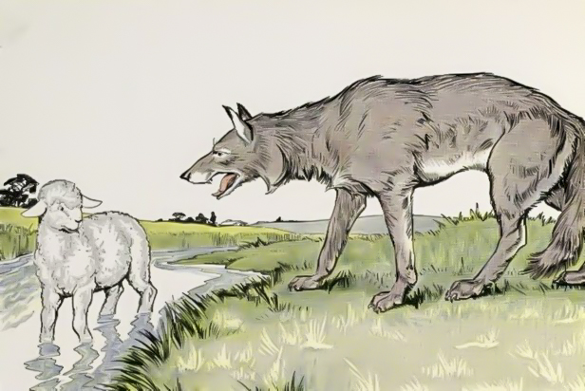
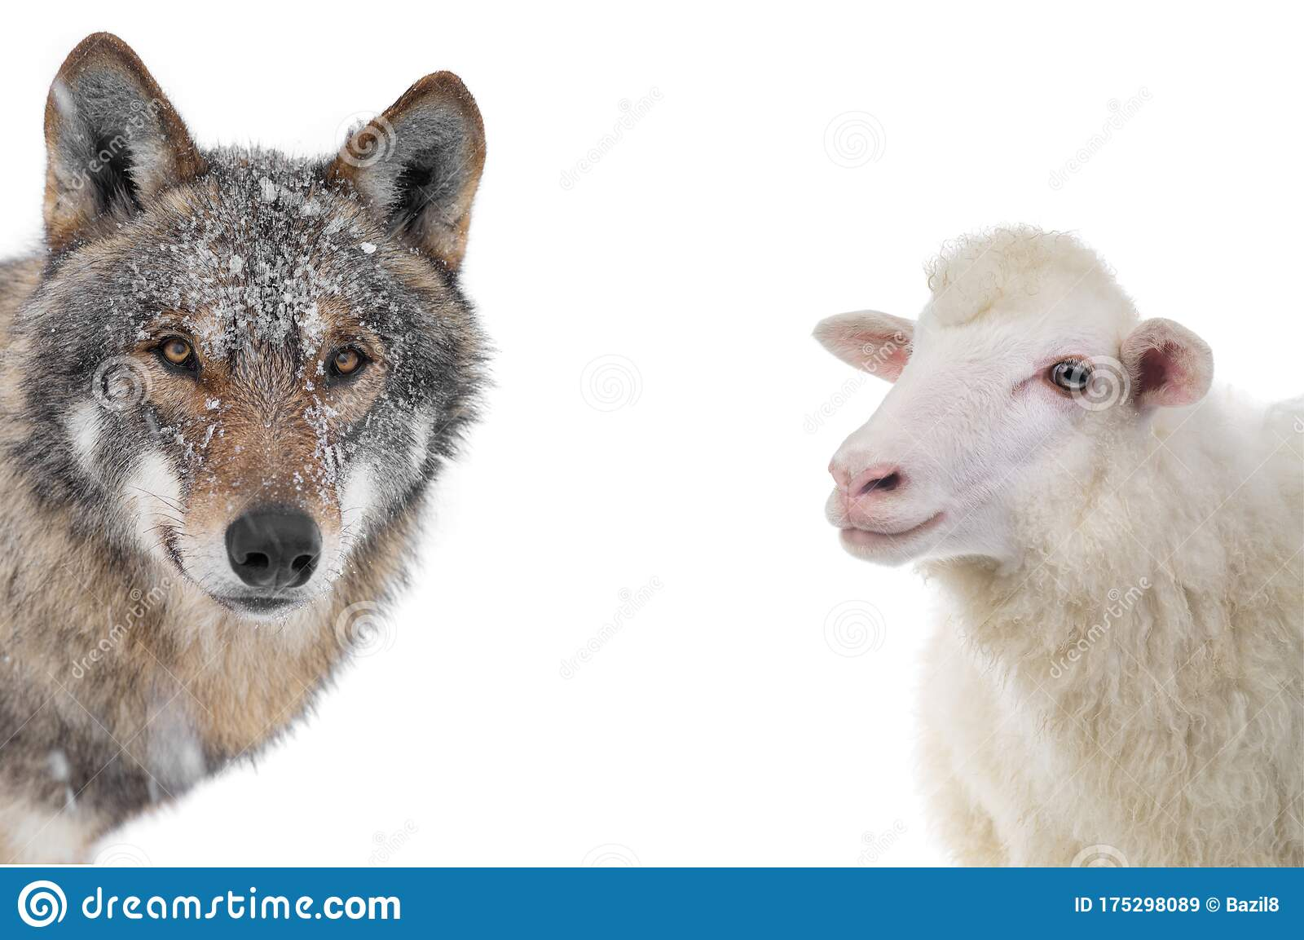
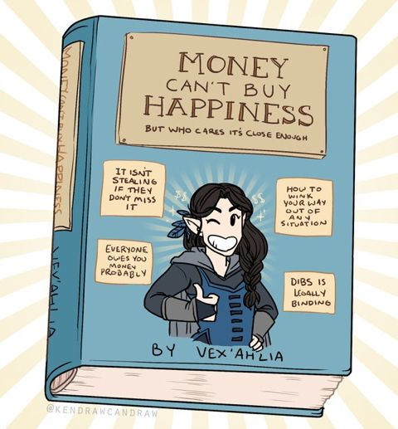
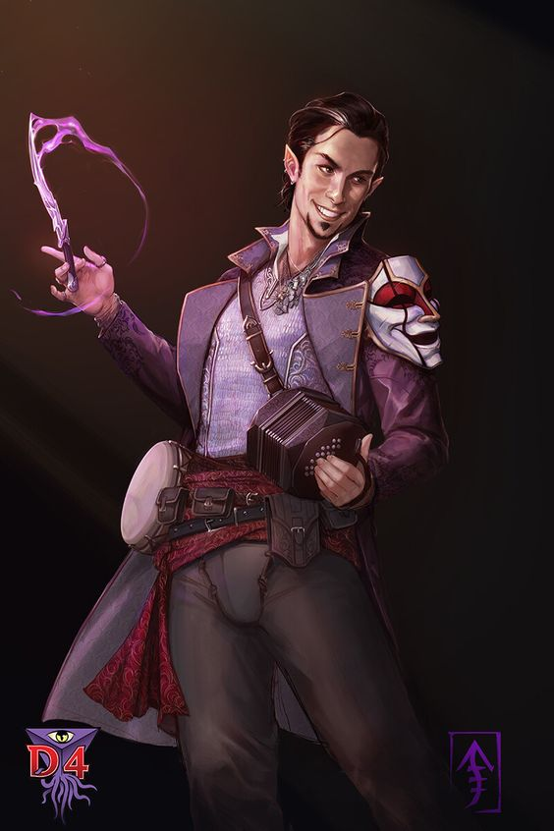
Abraxas x Delilah
Will they ever really say anything to each other?
Do they even know each others favourite colours?
Delilah could potentially save Abraxas from whatever evil shit she has planned which would be kinda romantic
She doesn’t care about his gabling problem
He’s been warned.

Slide 13
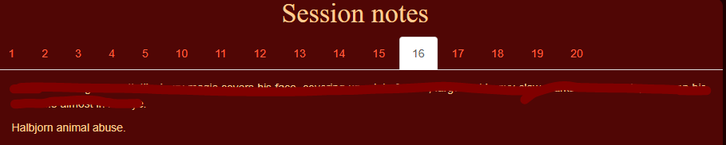





Hallbjorn x Masq
(Not even my session notes)
Have known each other for a while
Masq could do some freaky stuff but Hallbjorn would just want them for them
Hallbjorn really needs a hobby these wolves are getting out of control
They know each others (secret) backstories

Slide 14





Zarius x NO ONE
Lizard man
How does he even kiss?
No human form??
Are we sure he’s even capable of love?
Has gross deformities from being evil
Wasn’t in the etharis dating sim (for a reason)

Slide 15


You better make it canon (or I will)
Thank you for listening!

